Slide 1
product development cycle
Sherika Wynter
Product Manager, AARP Digital

Slide 2
learning objectives
product development cycle
Identify each phase of a product life cycle and the development stages teams must work through to develop those projects
Identify the different methods of developing a product
Notes:
- note that this methodology is probably the most standardized but is falling out of fashion, especially with smaller companies

Slide 3
product development cycle
product
life cycle

Slide 4
product life cycle
INTRODUCTION
DEVELOPMENT
GROWTH
MATURITY
Product Sales
DECLINE
Time
Notes:
Give an overview of the 5 main phases of a product life cycle and ask students to define each one: development, introduction, growth, maturity, and decline.
As you go through each phase of a product, explain what the product team should be focusing on, and common missteps. For example:
Adding new features during the introduction stage often times does not lead to growth. This is a time to increase marketing and user acquisition.
As a product begins to decline, adding new and exciting features will ramp things up back to introduction and growth.

Slide 5
How do we know where in the Lifecycle a product is located?
product life cycle
Notes:
Give an overview of the 5 main phases of a product life cycle and ask students to define each one: development, introduction, growth, maturity, and decline.
As you go through each phase of a product, explain what the product team should be focusing on, and common missteps. For example:
Adding new features during the introduction stage often times does not lead to growth. This is a time to increase marketing and user acquisition.
As a product begins to decline, adding new and exciting features will ramp things up back to introduction and growth.

Slide 6
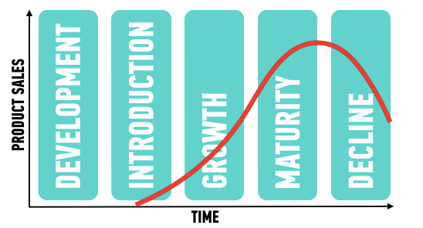
product life cycle
Key metrics
Cost of Acquisition
Revenue
Rate of Revenue Growth
AARRR Metrics
Notes:
Outline how the following metrics will give you insight into what phase you are currently in:
Cost of Acquisition
Revenue
Rate of Revenue Growth
AARRR Metrics (don’t need to go in depth here, we’ll cover AARRR metrics in more detail later in the course): Acquisition, Activation, Retention, Referral, Revenue

Slide 7
ACTIVITY
MySpace
Square
StumbleUpon
Twitter
Newspaper
FourSquare.com
LinkedIn
Blogger
Compact Discs
WordPress
iPod
Vimeo
TV
Gmail
Flickr
Amazon Kindle
Android
Outlook.com
Facebook
BlackBerry
As a class, we’ll analyze where companies fall on
product life cycle.
5 min
Draw the product life cycle curve on the whiteboard label its respective sections: introduction, growth, maturity, and decline.
Place companies (on post its) on the right part of the curve corresponding to their stage.
20 min
Chart with companies to the right at their respective
stages of the product life cycle.
Notes:
DEBRIEF QUESTIONS:
As a group, how did you approach this activity?
What was the most challenging part of that activity?
How did you overcome those challenges?
What information did you use in making those conclusions?
Throughout each of these phases, there are specific steps a product team should take to continue improving and developing the product.

Slide 8
product development cycle
the product development cycle

Slide 9
product development cycle
PLAN
CONCEIVE
DEVELOP
ITERATE
LAUNCH
STEADY STATE
MAINTAIN
OR KILL
Notes:
Outline the 7 different stages of the product development cycle by asking the class to define and hypothesize what encompasses each phase as you go through them.

Slide 10
product development cycle
conceive
CONCEIVE
Collate problems from R&D, customers, competitors, distributors, suppliers, etc…
Customer Interviews
Brainstorm Solutions
Figure out product focus
PLAN
DEVELOP
ITERATE
LAUNCH
STEADY STATE
MAINTAIN
OR KILL
Notes:
Identify: collate problems, brainstorm solutions, identify focus, etc.

Slide 11
product development cycle
plan
CONCEIVE
Research
Form business case
Buy in from stakeholders
Plan the product
Project Timelines
PLAN
DEVELOP
ITERATE
LAUNCH
STEADY STATE
MAINTAIN
OR KILL
Notes:
Plan: market research, business case, customer interviews, roadmapping, etc.

Slide 12
product development cycle
Business
Case
Research
Plan
Finalize
Market Research
Competitive Analysis
Customer Interviews
Initial plan for product
Roadmap estimates
Resources needed
Buy-in from stakeholders
Bring your KPIs
Strategic product plan
Roadmaps

Slide 13
product development cycle
develop
CONCEIVE
Build it!
Features
Stories / Specs
Resource Management
Development time
PLAN
DEVELOP
ITERATE
LAUNCH
STEADY STATE
MAINTAIN
OR KILL
Notes:
Develop: timelines, features, specs, development, etc.

Slide 14
product development cycle
iterate
CONCEIVE
Early Feedback
Test assumptions
Don’t wait until “done”
Alpha, Beta, Pilot, ...
Tweak & Evaluate
PLAN
DEVELOP
ITERATE
LAUNCH
STEADY STATE
MAINTAIN
OR KILL
Notes:
Evaluate: early feedback, test assumptions, betas, tweaks.

Slide 15
product development cycle
launch
CONCEIVE
Work with Marketing Team to position product
Public Launch
Dev Team Post Mortem
PLAN
DEVELOP
ITERATE
LAUNCH
STEADY STATE
MAINTAIN
OR KILL
Notes:
Launch: marketing, revenue, public launch, post mortem.

Slide 16
product development cycle
steady state
CONCEIVE
Collect Metrics - KPIs
Analyze & Optimize ROI
Support Marketing & Sales Efforts
Assess Continued Efforts
PLAN
DEVELOP
ITERATE
LAUNCH
STEADY STATE
MAINTAIN
OR KILL
Notes:
Assess: assess metric, analyze ROI, support marketing.

Slide 17
product development cycle
Maintain or kill
CONCEIVE
Major Upgrade
Begin the cycle all over
Freeze feature-set and manage revenue levels
Transition to End of Life
Message userbase
Establish EOL Plan
PLAN
DEVELOP
ITERATE
LAUNCH
STEADY STATE
MAINTAIN
OR KILL
Notes:
Maintain or Kill: major upgrade or establish an End-of-Life plan and message user base.

Slide 18
ACTIVITY
Detail the activities of a catering company putting together a dinner club meal mapping to the Product Development Life Cycle.
10 min
Discuss the activities needed to plan a dinner club meal.
Map each activity to a phase in the product development life cycle.
10 min
A table for each of the phases with one activity under each section using post it notes.
Notes:
DEBRIEF:
As a group, how did you approach this activity?
What was the most challenging part of that activity?
How did you overcome those challenges?

Slide 19
product development life cycle
product
development
process

Slide 20
waterfall,
product development process
agile,
lean
Notes:
Give an overview of the following 3 methods of developing a product.

Slide 21
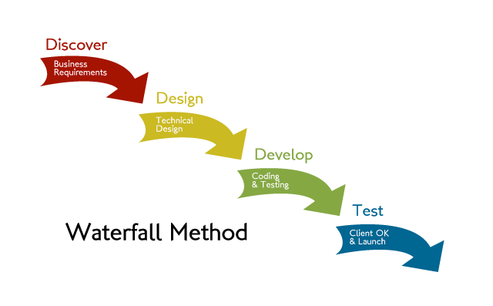
waterfall
product development process
Sequential
Pros
Known builds
Works well for Agencies
Cons
Inflexible & wasteful
Estimating Time & Cost is hard
Not tested throughout
Reduces collaboration on team
Notes:
Waterfall (ex. Microsoft)
Sequential
Pros: forces discipline, improved quality
Cons: inflexible
Give an example of a company that operates this way.

Slide 22
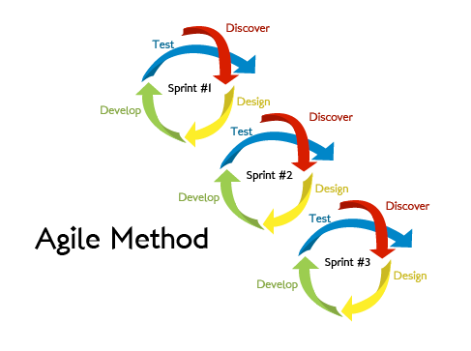
agile
product development process
Iterative
Pros
Faster Time to Market
Less Defects & Surprises
More collaboration on team
Increase in customer feedback
Cons
Misunderstood
Notes:
Agile (ex. Viacom)
Iterative
Pros: Faster to market, reduced budget, less defects
Cons: fickle stakeholders, reduced documentation & features
Overview of scrum and agile processes

Slide 23
Agile manifesto
product development process
Individuals and interactions over processes and tools
Working software over comprehensive documentation
Customer collaboration over contract negotiation
Responding to change over following a plan

Slide 24
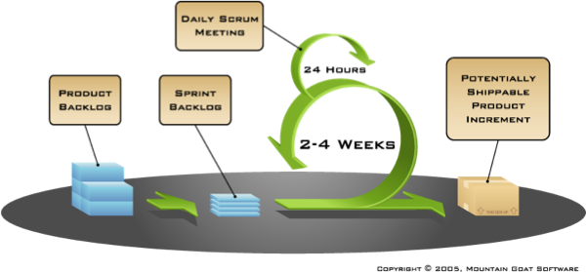
agile scrum
product development process

Slide 25
lean
product development cycle
Iterative & De-risking
Pros
Less waste
High customer input
Faster time to market
Less risk of performance in market
Cons
High level of finished product uncertainty
Need cross functional teams
think
Learn
Build
make
check
Measure
Notes:
Introduce Lean as a way to test your ideas before you build them.
The goal of Lean is to derisk your ideas before you invest tons of time and money in building them.

Slide 26
lean works in agile
product development process
Notes:
Lean should be done during each sprint of Agile. Lean and Agile do not compete, they can work together.
Do the Build Measure Learn cycle in each sprint.

Slide 27
product development cycle
homework

Slide 28
explain your chosen product or problem below.
your product
Notes:
Students should give a high level overview of the product or problem they would like to focus on.

Slide 29
product development life cycle

Slide 30
product development life cycle
http://ga.co/PDMticket
Notes:
Exit tickets are quick surveys students complete at the end of each class. It should only take about 5 minutes. This allows you to receive real time feedback and make any necessary changes.
Post exit ticket link on Schoology so students always have easy access.
Don't include WWW in the link as it produces an error.

